Slide 1
Image Classification Using Convolutional Neural Networks
R.Yaswanth

Slide 2
Convolutional Neural Networks
In neural networks, Convolutional neural network (ConvNets or CNNs) is one of the main categories to do image recognition, image classification. Object detection, recognition of faces etc., are some of the areas where CNNs are widely used.

Slide 3
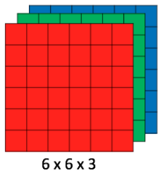
CNN image classifications takes an input image, process it and classify it under certain categories (Eg., Dog, Cat, Tiger, Lion). Computers sees an input image as array of pixels and it depends on the image resolution. Based on the image resolution, it will see h x w x d( h = Height, w = Width, d = Dimension ). Eg., An image of 6 x 6 x 3 array of matrix of RGB (3 refers to RGB values) and an image of 4 x 4 x 1 array of matrix of grayscale image.

Slide 4
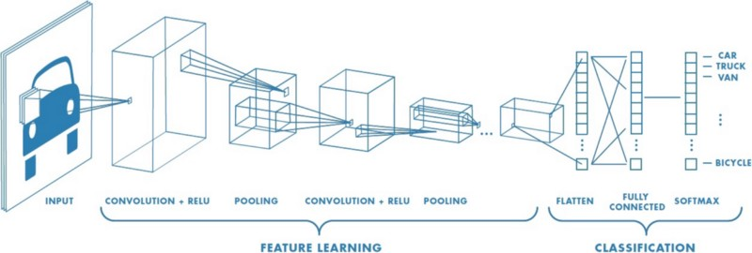
Technically, deep learning CNN models to train and test, each input image will pass it through a series of convolution layers with filters (Kernals), Pooling, fully connected layers (FC) and apply Softmax function to classify an object with probabilistic values between 0 and 1. The below figure is a complete flow of CNN to process an input image and classifies the objects based on values.

Slide 5
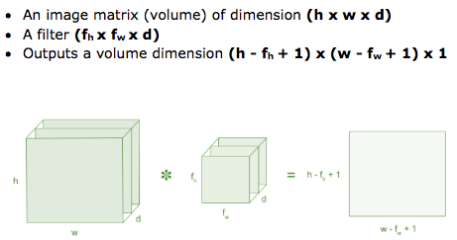
Convolution Layer
Convolution is the first layer to extract features from an input image. Convolution preserves the relationship between pixels by learning image features using small squares of input data. It is a mathematical operation that takes two inputs such as image matrix and a filter or kernal

Slide 6
Convolutional Layer
Padding
In order to use deep neural networks, we really need to use paddings.
To give it a general rule, if a matrix (nxn) is convolved with (fxf) filter/kernel give us n-f+1,n-f+1 matrix.
The convolution operation shrinks the matrix if f>1.
So the problems with convolutions are:
Shrinks output.
throwing away a lot of information that are in the edges.
To solve these problems we can pad the input image before convolution by adding some rows and columns to it. We will call the padding amount P the number of row/columns that we will insert in top, bottom, left and right of the image.
In almost all the cases the padding values are zeros.

Slide 7
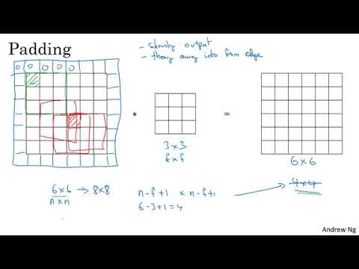

Slide 8
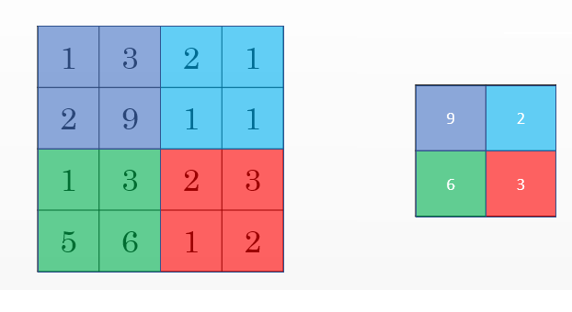
Pooling layers
Other than the conv layers, CNNs often uses pooling layers to reduce the size of the inputs, speed up computation, and to make some of the features it detects more robust.
Max pooling example:

Slide 9
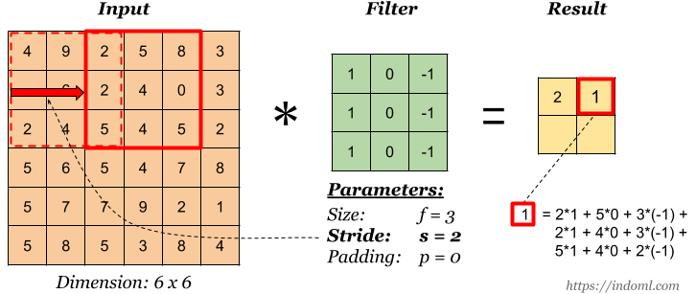
Strided convolution
Strided convolution is another piece that are used in CNNs.
We will call stride S.
When we are making the convolution operation we used S to tell us the number of pixels we will jump when we are convolving filter/kernel. The last examples we described S was 1.
Now the general rule are:
if a matrix (nxn) is convolved with (fxf) filter/kernel and padding P and stride S it give us (n+2p-f)/s + 1,(n+2p-f)/s + 1 matrix.
In case (n+2p-f)/s + 1 is fraction we can take floor of this value.

Slide 10
Batch normalisation
Batch normalisation is a technique for improving the performance and stability of neural networks
When input distribution varies, so does neuron output.
This results in neuron outputs that occasionally fluctuate into the sigmoid function’s saturable regions.
Once there, neurons can neither update their own weights nor pass a gradient back to prior layers.
If we can restrict neuron output to the area around zero, we can ensure that each layer will pass back a substantial gradient during backpropagation.
This will lead to faster training times, and more accurate results.

Slide 11
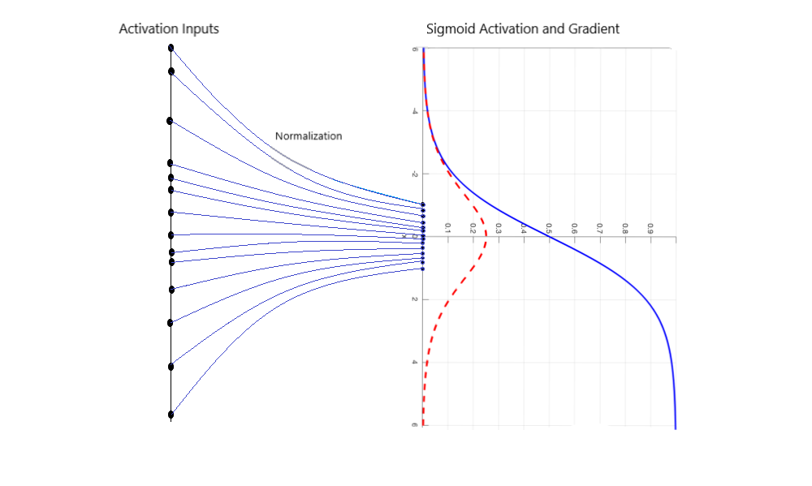

Slide 12
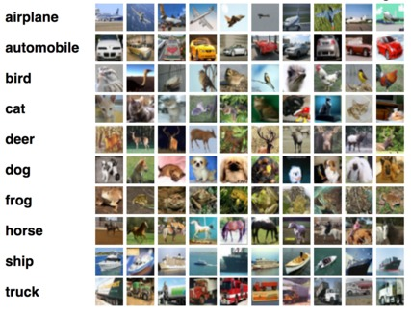
Task on CIFAR-10 Dataset with Keras: Convolutional Neural Networks

Slide 13
CIFAR-10 is an established computer-vision dataset used for object recognition. The CIFAR-10 data consists of 60,000 (32×32) color images in 10 classes, with 6000 images per class. There are 50,000 training images and 10,000 test images in the official data. The label classes in the dataset are:
Airplane
Automobile
Bird
Cat
Deer
Dog
Frog
Horse
Ship
truck

Slide 14
ELU:
Recently a new activation function named Exponential Linear Unit or its widely known name ELU was introduced. Researchs reveal that the function tend to converge cost to zero faster and produce more accurate results. Different to other activation functions, ELU has a extra alpha constant which should be positive number.
Dropout :
It is a technique for addressing this problem. The key idea is to randomly drop units (along with their connections) from the neural network during training. The reduction in number of parameters in each step of training has effect of regularization. Dropout has shown improvements in the performance of neural networks on supervised learning tasks in vision, speech recognition, document classification and computational biology, obtaining state-of-the-art results on many benchmark data sets

